Slide 1
Osmosis: Using Salt to Keep Trout Healthy
Brian McHail
Fisheries Technician
Cooperative Nursery Unit

Slide 2
Brian McHail
Penn State University
Wildlife & Fisheries Science-Fisheries Option
Edinboro University
Biology
Pennsylvania Fish and Boat Commission
Fisheries Biologist Aid
Fish Culturist
Fisheries Technician

Slide 3
Cooperative Nursery Unit
146 Sponsors, 160 Nurseries
~1.1 million brook, brown, rainbow, and golden rainbow trout fingerlings
Channel catfish, muskellunge, tiger muskellunge, largemouth bass, walleye, and perch
Participate in the steelhead and Lake Erie brown trout programs

Slide 5
Cooperative Nursery Unit
Provide technical guidance and support
Conduct semi-annual inspections
Conduct emergency visits
Administer $60,000 in grants
Conduct biennial regional seminars
Investigate prospective nursery sites

Slide 6
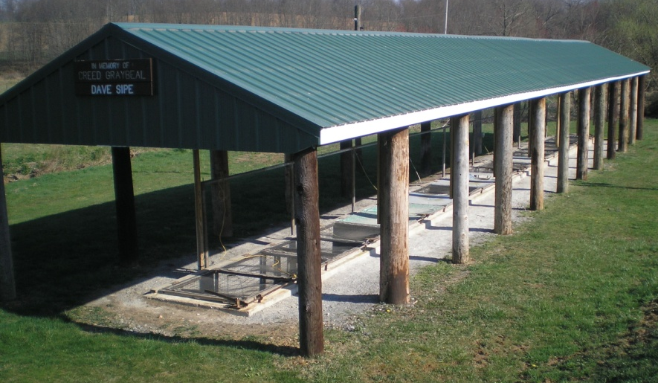
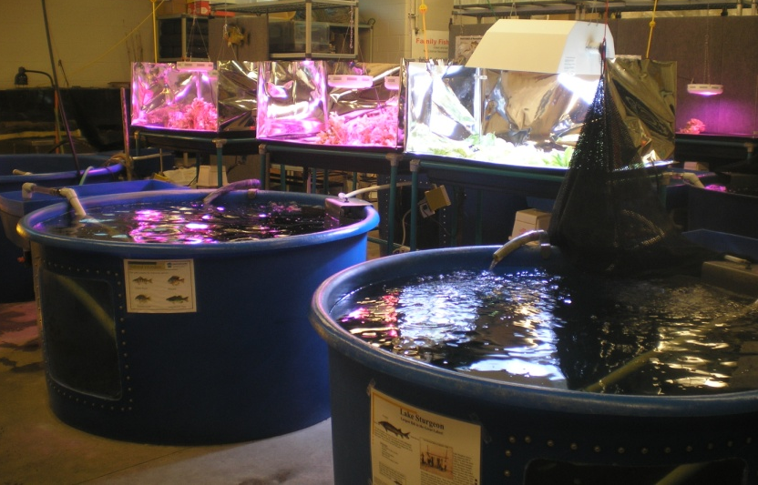

Slide 7
Cooperative Nursery Unit
Fairfield High School
St. Mary’s Middle School
Berlin Brothers Valley High School
Laurel High School

Slide 8
Overview
Osmoregulation/Osmosis
Freshwater and Saltwater Fish
Raisins and Grapes
Salt and its uses in fish health
Treatment dosages
Hands-on treatments

Slide 9
Osmoregulation
The process of maintaining an internal balance of salt and water in a fish’s body
Osmosis
Water moves from where there is less dissolved salt to where there is more

Slide 10
Freshwater Fish
Body fluids are saltier than freshwater
Constant flow of water into the body through osmosis (skin and gills)
Produce a large amount of diluted urine

Slide 11
Freshwater Fish

Slide 12
Saltwater Fish
Sea water is saltier than the body fluids
Constant flow of water from inside the body to the surrounding environment through osmosis (skin and gills)
Drink large amounts of sea water
Excrete excess salt through gills and digestive tract
Produce a small amount of salty urine

Slide 13
Saltwater Fish

Slide 14
Freshwater Fish
Can become “waterlogged” if excess water is not excreted
Saltwater Fish
Can become “dehydrated” if excess salt is not excreted

Slide 15
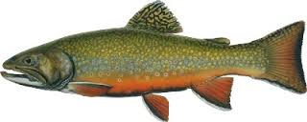
Raisins and Grapes
Raisins=Freshwater Fish
Raisins have a higher salt content than the surrounding water
Cells in the raisins take on the fresh water (osmosis)
Raisins become waterlogged

Slide 16
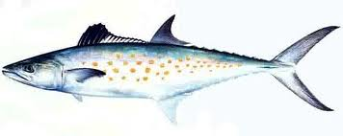
Raisins and Grapes
Grapes=Saltwater Fish
Grapes have a lower salt content than the surrounding water
Cells in the grapes lose water (osmosis)
Grapes become dehydrated

Slide 17
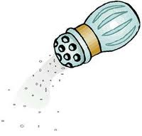
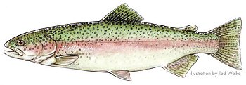
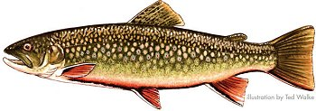
Using Salt to Keep Trout Healthy

Slide 18
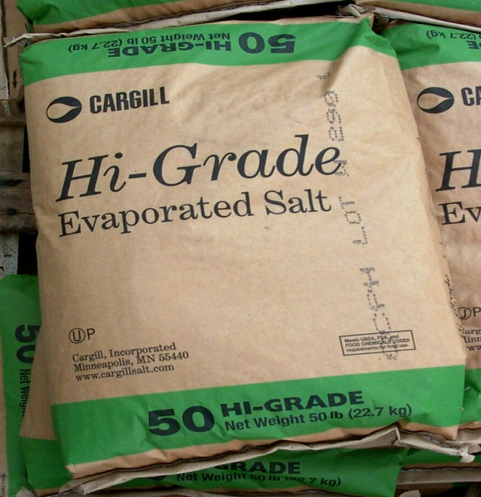
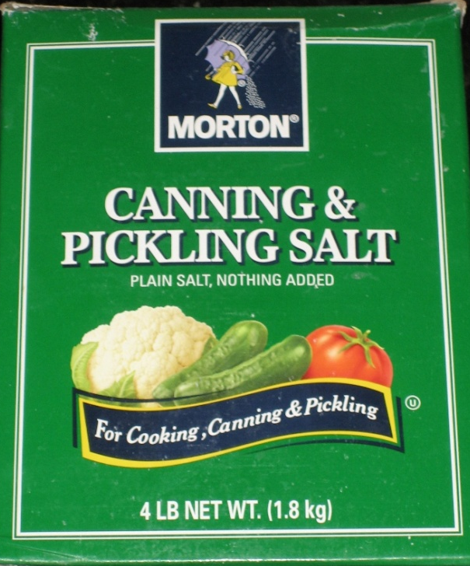
Salt
Hi-grade granular untreated salt
No additives
Available at feed stores
Salts to avoid
Rock salt
Water softener salt
Salt blocks

Slide 19
Why Salt?
No withdrawal period
No temperature restrictions
Low environmental impact
Easily accessible
Cost effective

Slide 20
Why Salt?
Low Regulatory Priority Drug (LRP)
Center for Veterinary Medicine (CVM; FDA) is unlikely to object to the use of salt if:
Used for the listed indications
Used at the prescribed levels
Used according to good management practices
Of an appropriate grade for use in food animals
Unlikely to have an adverse effect on the environment

Slide 21
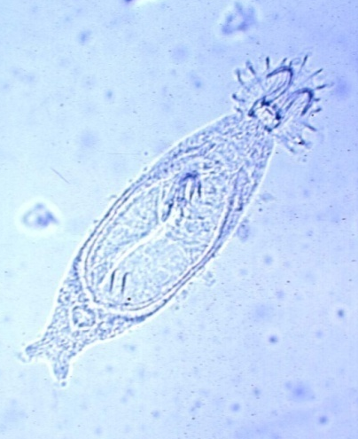
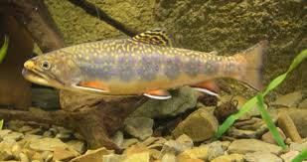
Why Salt?
Low Regulatory Priority Drug (LRP)
Osmoregulatory aid
Parasiticide

Slide 22
Osmoregulatory Aid
Stress Relief
Aquarium environment
Water quality issues
Density issues
Replacement fish
Transportation
New environment

Slide 24
Osmoregulatory Aid
Osmolality of fish increases as salinity increases
Osmolality-an indication of total dissolved particles per unit volume

Slide 25
Osmoregulatory Aid
Plasma osmolality ~320 mOsm/kg
Salinity=Plasma osmolality
Osmotic and ionic gradients are reduced to where severe ion and water imbalances do not occur
Reduction in energy spent on osmo- and ionoregulation results in healthier fish

Slide 26
Parasiticide
External Pathogens
Improper tank maintenance
Fish from external sources
Replacement fish

Slide 27
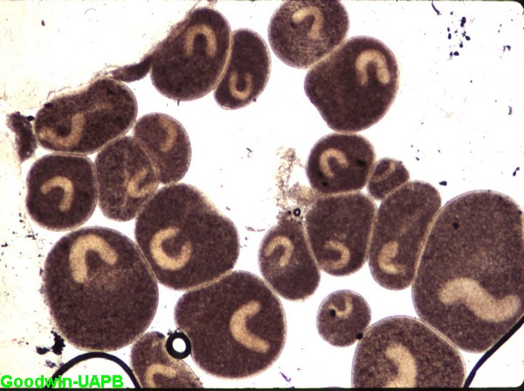
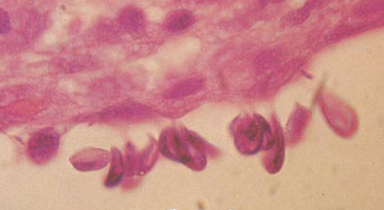
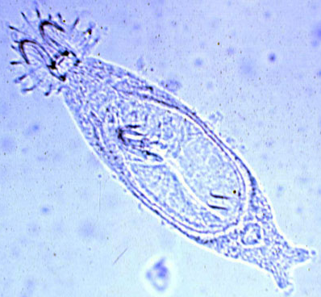
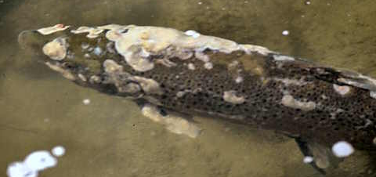

Slide 28
When to Start a Salt Treatment?
Prophylactic Treatment
Prior to a water change
0.5% salt solution
Therapeutic Treatment
Disease episode
1% -3% salt solution

Slide 29
Salt Treatment Table 30 Minute Treatment Concentration
% Solution | lbs/gal
0.5% | 0.0417
1% | 0.0834
2% | 0.1668
3% | 0.2502

Slide 30
Prophylactic Treatment
% Solution (0.5%)
Water volume (gallons)
30 minute bath treatment

Slide 31
Salt Treatment Table 30 Minute Treatment Concentration
% Solution | lbs/gal
0.5% | 0.0417
1% | 0.0834
2% | 0.1668
3% | 0.2502

Slide 32
Prophylactic Treatment
Lbs of salt = (salt lbs/gal) X (gal of water)
Lbs of salt = (0.0417 lbs/gal) X (53 gal)
Lbs of salt = 2.2101 lbs

Slide 33
Prophylactic Treatment
Do not feed the day of the treatment
Turn off filtration
Continue to run chiller and aeration
Remove ~1 gallon of water and place in a bucket with the salt
Mix and dump into the tank
After 30 minutes remove water and replace with new water

Slide 34
Prophylactic Treatment
Make sure new water is suitable for the fish
Temperature and pH
Chill water if needed
Stagger water changes over 2 days
10 gallons immediately after treatment
10 gallons the following day

Slide 35
Therapeutic Treatment
% Solution (1%-3%)
Water volume (gallons)
30 minute bath treatment

Slide 36
Salt Treatment Table 30 Minute Treatment Concentration
% Solution | lbs/gal
0.5% | 0.0417
1% | 0.0834
2% | 0.1668
3% | 0.2502

Slide 37
Therapeutic Treatment
Lbs of salt = (salt lbs/gal) X (gal of water)
Lbs of salt = (0.0834 lbs/gal) X (53 gal)
Lbs of salt = 4.4202 lbs
Follow the same treatment guidelines as the prophylactic treatment in regards to aquarium care

Slide 38
Not Enough Salt?
Volume Reduction
Lbs of salt = (0.0834 lbs/gal) X (53 gal)
Lbs of salt = 4.4202 lbs
Lbs of salt = (0.0834 lbs/gal) X (33 gal)
Lbs of salt = 2.7522 lbs

Slide 39
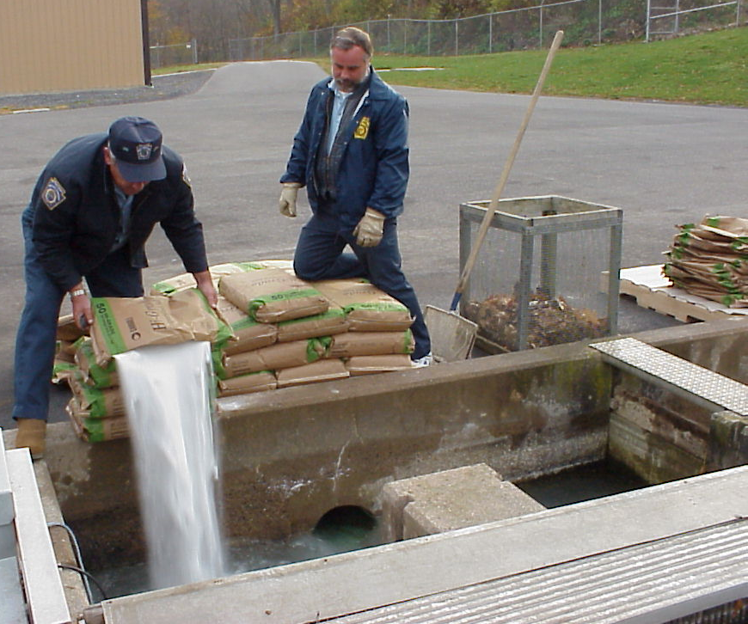
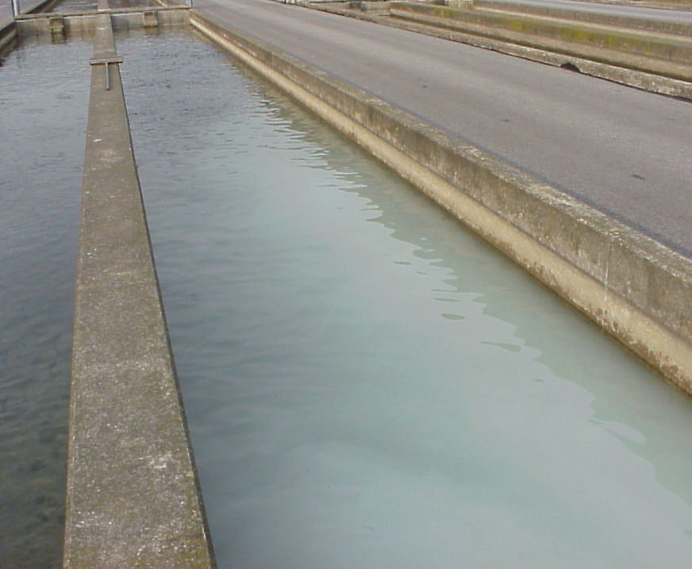

Slide 40
Bath Treatment Example

Slide 41
Therapeutic Treatment
Dip Treatment
Replacement fish or current fish (if possible)
3% salt solution
2 buckets: 1 with freshwater and 1 with 3% salt solution
Bucket water and aquarium water must be close in temperature
Refrigerate/chill if necessary

Slide 42
Therapeutic Treatment
Dip Treatment
Mix salt in a bucket with 2-3 gallons of water
Place aeration in the bucket
Dip a net full of fish in the bucket until fish lose equilibrium (10-60 seconds)
Dip the net full of fish in the rinse bucket (1-2 seconds) and place in aquarium

Slide 43
Salt Treatment Table 30 Minute Treatment Concentration
% Solution | lbs/gal
0.5% | 0.0417
1% | 0.0834
2% | 0.1668
3% | 0.2502

Slide 44
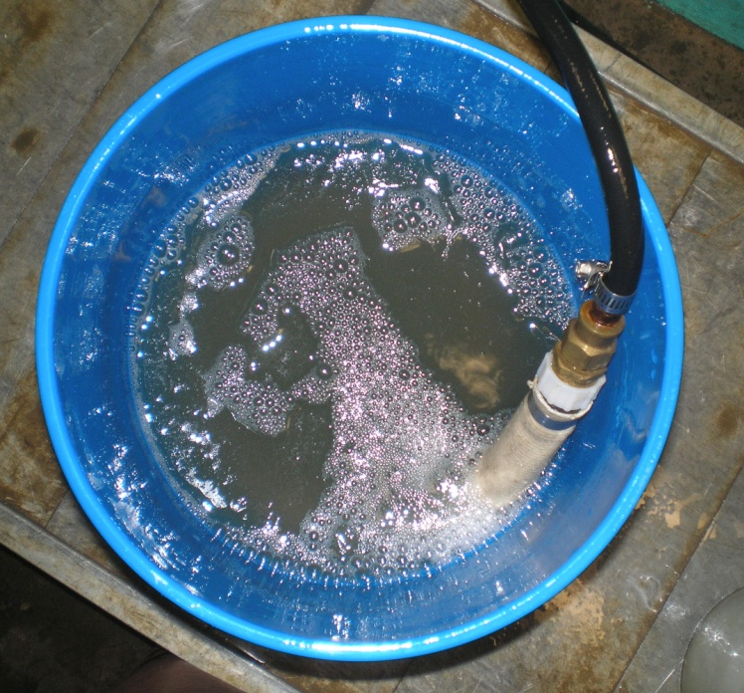
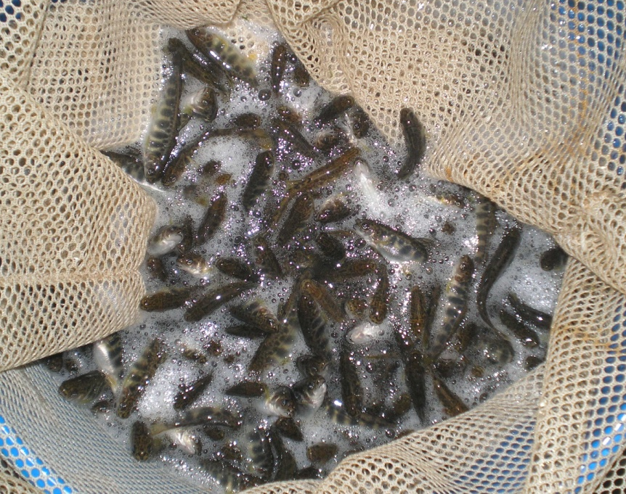
Therapeutic Treatment
Dip Treatment
Lbs of salt = (0.2502 lbs/gal) X (3 gal)
Lbs of salt = 0.7506 lbs

Slide 45
Salt Treatments
Prophylactic Treatment
30 minute bath treatment (0.5%)
Therapeutic Treatment
30 minute bath treatment (1%)
Dip treatment (3%)

Slide 46
Dip Treatment Example

