Slide 2
Eggs
Alevins
Fry/
Fingerlings
Adult
Tank
Misc.
$100
$100
$100
$100
$100
$100
$200
$200
$200
$200
$200
$200
$300
$300
$300
$300
$300
$300
$400
$400
$400
$400
$400
$400
$500
$500
$500
$500
$500
$500

Slide 3
The eggs are considered dead if they are this color

Slide 4
What is White
Back to
Main
Screen

Slide 5
In nature, eggs are buried in gravel to protect them from this warming daily occurrence

Slide 6
What is sunlight
(or light or UV rays)
Back to
Main
Screen

Slide 7
When the eggs arrived at school they were considered what type of eggs, as their eyes were visible

Slide 8
What is eyed eggs
Back to
Main
Screen

Slide 9
Sharing a name with a color, the eggs live in a nest, called this

Slide 10
What is a redd
Back to
Main
Screen

Slide 11
The degree of egg development depends entirely on this

Slide 12
What is water temperature
Back to
Main
Screen

Slide 13
Like a chicken egg, Trout absorb food from this as it is attached to their body

Slide 14
What is the yolk sac
Back to
Main
Screen

Slide 15
Once the yolk sac has been absorbed the fish swim where to fill up their swim bladder

Slide 16
What is the surface
Back to
Main
Screen

Slide 17
Another name for trout at this stage is this, as they have a sac attached to their fry like body

Slide 18
What is
sac fry
Back to
Main
Screen

Slide 19
Alevins live here until their yolk sac is absorbed

Slide 20
What is gravel (redd or nest also ok)
Back to
Main
Screen

Slide 21
As alevins, these are not well developed so the trout absorb oxygen through their skin.

Slide 22
What are gills
Back to
Main
Screen

Slide 23
As fry, trout immediately begin to search for this life sustaining substance

Slide 24
What is food
Back to
Main
Screen

Slide 25
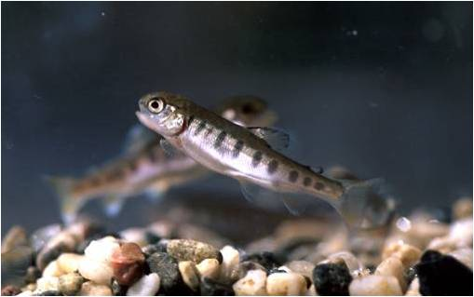
Golfers are very familiar with these black finger-like markings on the fry, called this

Slide 26
What are parr marks
Back to
Main
Screen

Slide 27
After the alevin enter this stage in which the yolk sac is absorbed, or fastened-up, the fish are considered fry

Slide 28
What is the button-up stage
Back to
Main
Screen

Slide 29
Fry that do not learn to eat are considered this as they have thin needle like bodies and big heads

Slide 30
What are pinheads
Back to
Main
Screen

Slide 31
To be considered a fingerling, trout must be how many inches

Slide 32
What is 1-3 inches
Back to
Main
Screen

Slide 33
Trout are considered adults after this many years

Slide 34
What is 2-3 years
Back to
Main
Screen

Slide 35
The very low percent of brook trout eggs to survive to adult

Slide 36
What is 2%
Back to
Main
Screen

Slide 37
Females lay eggs in the gravel, or a nest called this, sharing its name with a color

Slide 38
What is a redd
Back to
Main
Screen

Slide 39
Like the name of the nest where trout lay their eggs, the adult brook trout will have what color dots along its side

Slide 40
What is red
Back to
Main
Screen

Slide 41
About the same time students are retuning to school in Sept. brook trout spawn (lay their eggs) in this season

Slide 42
What is fall
Back to
Main
Screen

Slide 43
The tank uses a chiller because trout live in what type of water

Slide 44
What is cold water
Back to
Main
Screen

Slide 45
What piece of equipment in the tank functions similar to a wetland absorbing impurities

Slide 46
What is the filter
Back to
Main
Screen

Slide 47
If the water lacks this element, the trout will swim to the surface with gapping mouths and rapid movement of gill coverings

Slide 48
What is oxygen
Back to
Main
Screen

Slide 49
When testing to see if the water is too acidic or basic, we are using this test

Slide 50
What is pH
Back to
Main
Screen

Slide 51
Daily
Double!!

Slide 52
Trout experiencing respiratory stress is caused by high level of what chemical

Slide 53
What is ammonia
Back to
Main
Screen

Slide 54
This is the Pennsylvania state fish

Slide 55
What is Brook Trout
(must say “Brook” as there are many different Trout species)
Back to
Main
Screen

Slide 56
The Junior High sits in what watershed

Slide 57
What is the Loyalhanna Watershed
Back to
Main
Screen

Slide 58
As fly fishermen know, Brook trout’s diet mainly consists of

Slide 59
What are insects, flies, or macroinvertebrates
Back to
Main
Screen

Slide 60
The Loyalhanna eventually flows into the Allegheny then this river before flowing into the Mississippi River then the Gulf of Mexico

Slide 61
What is the Ohio River
Back to
Main
Screen

Slide 62
Brook Trout are indicators of healthy streams because they can’t live in this type of water

Slide 63
What is polluted water
Back to
Main
Screen

